Slide 1
MSDS 6306: Case Study 1 – Craft Beer Craft Dogs – Rick, Joe, and Jason

Slide 2
Agenda
Problem
Key Metrics
Conclusion

Slide 3
Executive Summary
Budweiser wants to break into the craft beer market
Current trends in the craft beer market
Strategic areas for growth

Slide 4
Source Data
2400 beers from 558 breweries
40% data missing from IBU and 2.5% missing from ABV
Data was dropped/imputed
Median ABV is

Slide 5
US Craft Brewery Locations
Colorado has the most breweries with 47
Other than Colorado, the other states with the most breweries tend to be clustered along US border and coasts
The top 5 states (CO,CA,MI,OR, & TX) contain 31% of the countries craft breweries

Slide 6
Types of Craft Beers
There are 100 different style of craft beers brewed in the US
Classes of Beer have many variants such as Ales which have 28 unique style such as English Pale, Irish Red, etc
When grouped into classes, IPA’s and Ales account for 64% of all craft beers

Slide 7
Addressing Missing Values in the data set
42% of the beers are missing IBU information, 2.6% are missing ABV information
Should these data points be excluded from analysis or estimated from other information available?
IBU is very different for each style of beer
If the overall mean IBU is 50, that would not a good estimate for Witbiers or IPA’s
We imputed missing values with the mean of their respective Class of Beer

Slide 8
IBU and ABV by State
DE and WV show higher IBU than other states, but this is because they only have two beers per state which happen to be high IBU varieties
For states with sufficiently larger sample sizes all have median IBU in the mid-30’s
Almost all states have a median ABV in the 5% to 6% Range
Utah is an outlier with ABV of 4% because of state laws limiting to a max ABV of 4%
* Medians calculated using beer class-mean method of imputing missing values

Slide 9
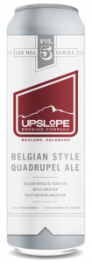
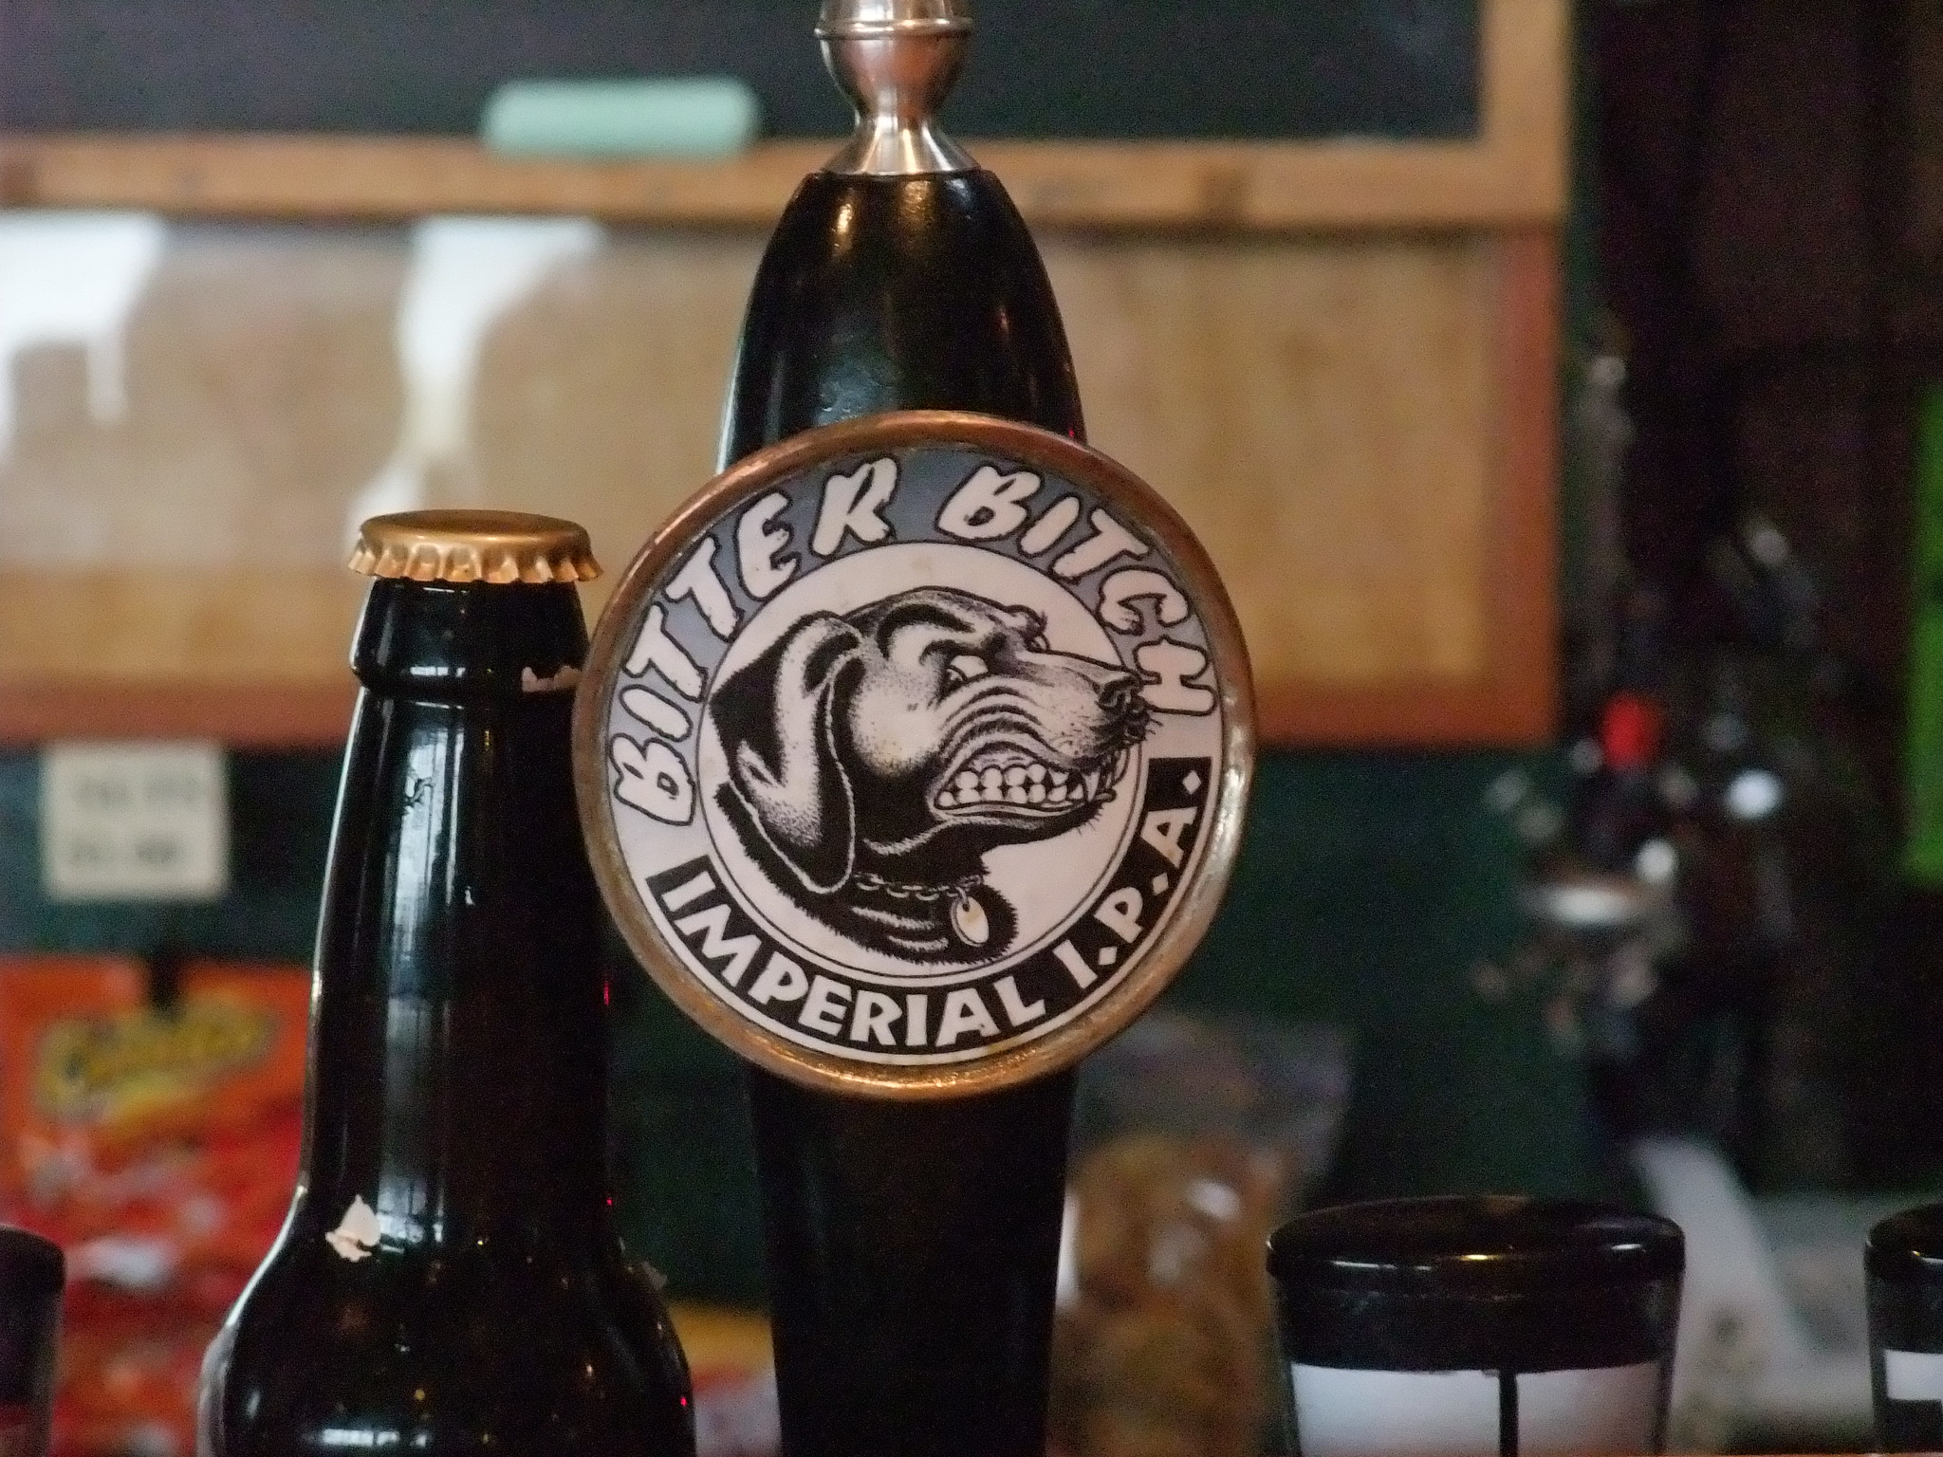
Maximum IBU and ABV Beers
ABV = 12.8%
Upslope Brewing Company, Colorado
Lee Hill Series Vol. 5 - Belgian Style Quadrupel Ale
Brewed with a select strain of Belgian yeast and traditional Belgian candi syrup, the beer matured over six months to mellow and soften its character.
IBU = 138
Astoria Brewing Company, Oregon
Bitter Bitch Imperial IPA
A big IPA with a huge bite. Peoples Award Winner 3 Years running a the Spring Beer & Wine Festival, Portland, OR.

Slide 10
IBU and ABV Relationship
ABV and IBU are positively correlated with 45% of the variation in ABV explained by IBU
The IBU/ABV relationship is different or shifted for different styles of beer

Slide 11
Appendix
Additional explorations to handling missing values, and determination of appropriate methods

Slide 12
Addressing Missing Values in the data set
42% of the beers are missing IBU information, 2.6% are missing ABV information
Should these data points be excluded from analysis or estimated from other information available?

Slide 13
Method 1: Impute missing values based on Predictive Mean Matching
This method replaces missing values such that the new completed data set mimics the overall distribution of existing IBU and ABV data available
Does this make sense to use? Is there a better way?

Slide 14
Issues with Imputing based on predictive means for entire sample distribution
IBU is very different for each style of beer
If the overall mean IBU is 50, that would not a good estimate for Witbiers or IPA’s
Would imputing based on style of beer be more useful?

Slide 15
Method 2: Replace missing values with mean of respective Class of Beer
PMM mimics original distribution, Class-Mean stacks up at Ales & IPA’s (most missing values)
Are each of these methods more valid for certain types of analysis?

Slide 16
Relationship Analysis for different imputation methods
PMM set matches correlation fit of originally available data
Class Mean method shifts the correlation line
In this instance, relationship study may be best performed by excluding missing value

Slide 17
Summary Statistics for different imputation methods
All South Dakota beers are missing IBU data
PMM method replaces with values in tail of distributions for their style of beer
Class Mean method replaces with IBU values more representative for type of beer
SD mean with PMM = 50 and with Class Mean = 34
Calculating median values by State, style of beer etc. make more sense with Class Mean replacement
PMM method
Class-mean method

Slide 18
Summary Statistics for different imputation methods
All South Dakota beers are missing IBU data
PMM method replaces with values in tail of distributions for their style of beer
Class Mean method replaces with IBU values more representative for type of beer
SD mean with PMM = 50 and with Class Mean = 34
Calculating median values by State, style of beer etc. make more sense with Class Mean replacement
PMM method
Class-mean method

Slide 19
Data Outliers
Highest ABV
Lee Hill Series Vol 5. Belgian Quadrupel Ale– 12.8% ABV
Upslope Brewing Company (Boulder, CO)
Highest IBU
Bitter Bitch Imperial IPA – 8.2% ABV and 138 IBUs
Astoria Brewing Company (Astoria , OR)

Slide 20
US Craft Brewery Locations

Slide 21
Missing Values
42% of the beers are missing IBU information, 2.6% are missing ABV information
Should these data points be excluded from analysis or estimated from other information available?

Slide 22
Method 1: Impute missing values based on Predictive Mean Matching
This method replaces missing values such that the new completed data set mimics the overall distribution of existing IBU and ABV data available
Does this make sense to use? Is there a better way?

Slide 23
Issues with Imputing based on predictive means for entire sample distribution
IBU is very different for each style of beer
If the overall mean IBU is 50, that would not a good estimate for Witbiers or IPA’s
Would imputing based on style of beer be more useful?

Slide 24
Method 2: Replace missing values with mean of respective Class of Beer
PMM mimics original distribution, Class-Mean stacks up at Ales & IPA’s (most missing values)
Are each of these methods more valid for certain types of analysis?

Slide 25
Relationship Analysis for different imputation methods
PMM set matches correlation fit of originally available data
Class Mean method shifts the correlation line
In this instance, relationship study may be best performed by excluding missing value

